Slide 1

City of South Bend
Office of Diversity & Inclusion
2024 2025 Annual Report
Title page stays the same

Slide 2

Remove Page

Slide 3
Contents
Background on ODCI
Mission and Vision Statements
2024 Accomplishments/Highlights
Internal Staffing Updates
2025 Projected Activities & Goals
Proposed 2025 Content
Executive Summary
ODI Roles
Mission/Vision
Annual Spend Analysis
Capacity Building Efforts
Partnerships and Community Impact
Successes and Challenges
2026 Strategic Priorities
Report Closing

Slide 4
Background
Remove this page
Disparity Study
In response to the 2020 disparity study, the City of South Bend identified areas where city spending could improve in utilization and spending with minority and women-owned business enterprises. Consequently, the Office of Diversity, Compliance, and Inclusion prioritized their efforts, starting with Public Works projects. The disparity study pinpointed specific NAICS codes and helped the city set weighted goals to encourage prime contractors to utilize more minority and women-owned business enterprises.

Slide 5
Mission Statement
Mission may have room to be modified
Mission
We provide access to tools and resources that foster inclusive workplaces, workforces, communities, and city procurement opportunities. We deliver inclusive policy infrastructure, and public/ private program partnerships that expand access to talent pools, enforce fair and equitable employment, housing, public accommodations, education practices, and assist in fostering vibrant and inclusive city economies.

Slide 6
Vision Statement
Room for revision to better align with ODI current function
Our Vision is for South Bend to be an open, connected community where everyone can thrive regardless of background, well known as a place where talent meets purpose in pursuit of shared goals.
At our core, our Values in our administration and in our community are:
Inclusion- reflect, support and develop the community we serve in opportunity, access, and decision making
Empowerment- encourage a culture of contribution to create a safe, health, and meaningful life in South Bend
Excellence- be the best in Indiana or in the 25% nationally for major area service delivery and resident well-being
Accountability- be transparent stewards of government resources and hold one another to high standard of respect and support of our community
Innovation- deliver better services more efficiently and developing the best ideas through creativity, inquiry, and evidence to continually improve

Slide 7
MWBE Certified Spend
The City’s spend with minority and women owned business enterprises in 2024 was over $14,700,000. This was an increase of over $2,500,000 from what was spent with minority and women owned businesses in 2023. ($12,000,000)
MWBE(certified) spend in 2024 was $2,713,751. Although a number of our minority and women owned businesses are not yet certified, the City spent $5,144,541 with these businesses in 2024. Certified subcontractors spend was $6.9
The Office of Diversity & Inclusion continues to encourage all minority and women owned businesses who are included in the City’s spend to become certified.
Revise this section to encompass the annual spend analysis. Which will include M/W spend, year-over-year spending, breakdowns by firm type, etc...
May include data charts and subsections.

Slide 8
Accomplishments
Section will be revised to capacity building efforts.
This will showcase, outreach, programs and events
Increase
In 2024, the number of certified Minority and Women Business Enterprises totaled 55, which is an increase from a total of 44 in 2023.
The City spend included approximately 106 minority/and or women owned businesses in 2024. (72 in 2023)
Assisted in increasing the number of certified businesses by holding three cohorts for Certification sessions. These sessions were held in March, June, and September of 2024, and were very successful with 69 participants engaging in the training, of which 15% became certified. Sessions will be held on a quarterly basis to increase MWBE capacity.

Slide 9
Accomplishments Cont’d
Small Business Assistance Suite (B-Suite)
The Office of Diversity & Inclusion in partnership with IMPower, was able to strengthen partnerships, stabilize operations, implement key process improvements, and lay the groundwork for more consistent, high quality service delivery within the Small Business Suite Program and provided the following in 2024:
Participants served 75 (49 completed, 26 in progress)
Total Coaching Hours Administered 193
Tax Vouchers Administered 2
Bookkeeping Vouchers Administered 16
Legal Vouchers Administered 16

Slide 10

2024 Performance Highlights
Program Reach:
  Served 75 participants
Participant Demographics:
  Over 90% minority representation
  50% women representation
Service Delivery:
  193 total coaching hours delivered
Professional Service Vouchers Distributed:
  16 Bookkeeping vouchers
  16 Legal vouchers
  2 Tax vouchers

Slide 11
Participant Engagement & Feedback
"The experience was overall amazing and helpful... I have doubled my sales."
- NeKisha Roberson
"The B Suite was an absolute blessing and Leroy
King went above and beyond to not only inform
but he also inspired and encouraged and
motivated me to just go for it."
-Corry Coleman (also became a certified MBE)
"This one program set my business up to have its
most profitable year yet in 2024... I hope that
every new business owner utilizes this service. I
have benefited so much from it. Thank you!"
-Felicia Seals Buchanan
"This was the MOST tiring and exhausting step to
figure out and if it wasn’t for the B Suite I
seriously don’t know where we’d be."
-Kamika Perry (also became a certified MBE)

Slide 12
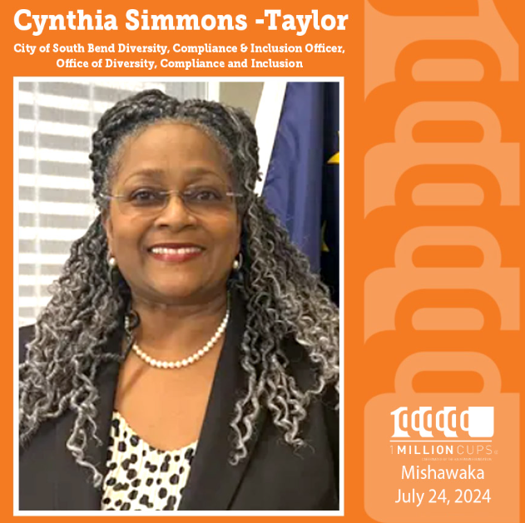
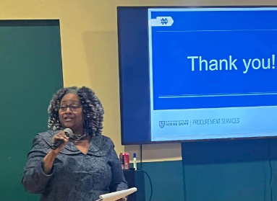

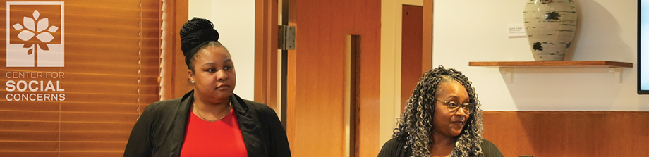
Partnerships
This section will identify:
Partnerships
Events we participated in
Partner Participation
2024 ODCI was invited to participate as presenters at several events.
SPARK Business Accelerator
South Bend Entrepreneurial Adversity Program (SBEAP)
Women’s Entrepreneurial Summit
NDU Center for Social Concerns
IDEA Week
Reparatory Justice Commission
St. Joseph County Public Library
Intercultural Relationship Institute’s Thought Leadership Conference
Indiana Black Expo Black Business Training Institute
NIMBA
NDU Procurement Team
WSBT Hometown Living

Slide 13

2025 Planned Enhancements
Overview of strategic plan for 2026
Introduction of topic-specific workshops
Enhance networking events such as The Prime & Sub Connect & Community Conversations with ODCI
Implementation of new KPIs aligned with Mayor's Office objectives
Strengthen participant follow-up protocols, by allowing continued engagement with business coaches.
Enhance performance measurement systems
Optimize resource allocation across service categories

Slide 14

2025 Planned Enhancements Cont’d
Assist with focusing on building a culturally competent and inclusive workforce within the city's departments.
Provide training, resources, and strategies to improve diversity and inclusion. [Executive Order No. 01-2016]
Aim to support departments in assessing and implementing Diversity and Inclusion strategies.

Slide 15
Focused on increasing the participation of Minority Business Enterprises (MBEs) and Women Business Enterprises (WBEs) in city contracts by 5%
Provides guidance and resources to help these businesses navigate procurement processes.
Providing quarterly networking opportunities for Prime contractors and subcontractors to connect and build relationships.
We will cover goals for 2026
2025
Supplier Diversity
Goals

Slide 16
Staffing
The Office of Diversity & Inclusion had one staffing change (Contract Compliance Administrator) in 2024 and is now staffed with the following:
Cynthia Simmons-Taylor, a 28- year City employee is the Officer of Diversity, Compliance & Inclusion and oversees the department.
Michael Szymanski is Contract Compliance Administrator and is responsible for assigning goals to Public Works’ projects for the inclusion of minority and women owned businesses, as well as monitors certified MWBE inclusion.
Bianca Jones is the Manager of our Inclusion Project, and she organizes programing, partnerships, certification, and other education and outreach efforts to build out our eco system.

Slide 17
Objective & Policy
Our objective is to promote equal opportunity for minority and women-owned business, including small local and emerging businesses (SLEBE), and to encourage utilization of such businesses in City contracting and procurement by helping to remove the barriers to the participation of underutilized minority and women business enterprises.
South Bend’s policy is to ensure nondiscrimination in the award and administration of City contracts and to take affirmative steps to address past discrimination by creating a level playing field on which underutilized minority and women business enterprises can compete fairly for City contracts.

Slide 18

CONCLUSION
Office of Diversity & Inclusion: The City of South Bend’s driving force continues to be committed to fostering a diverse, compliant, inclusive, and equitable environment. We believe that supporting local businesses from various backgrounds is a crucial step in achieving these goals.

