Slide 1
Department of Community Investment
August 26, 2024

Slide 2
Agenda:
Bill No. 24-28 Confirming Resolution - Personal Property Tax Abatement 1710 North Sheridan Street

Slide 3
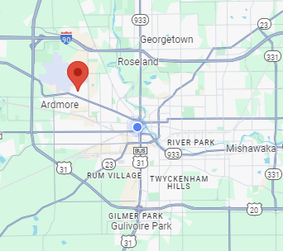
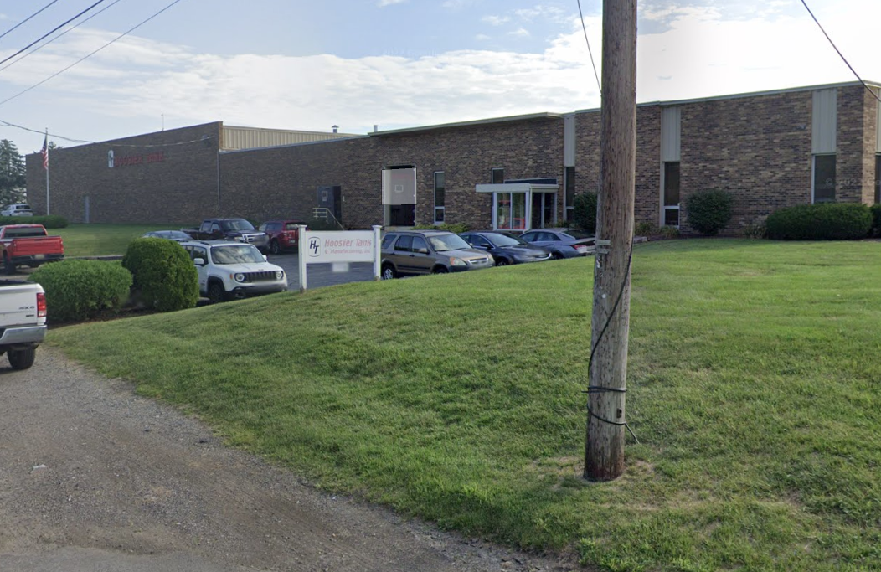
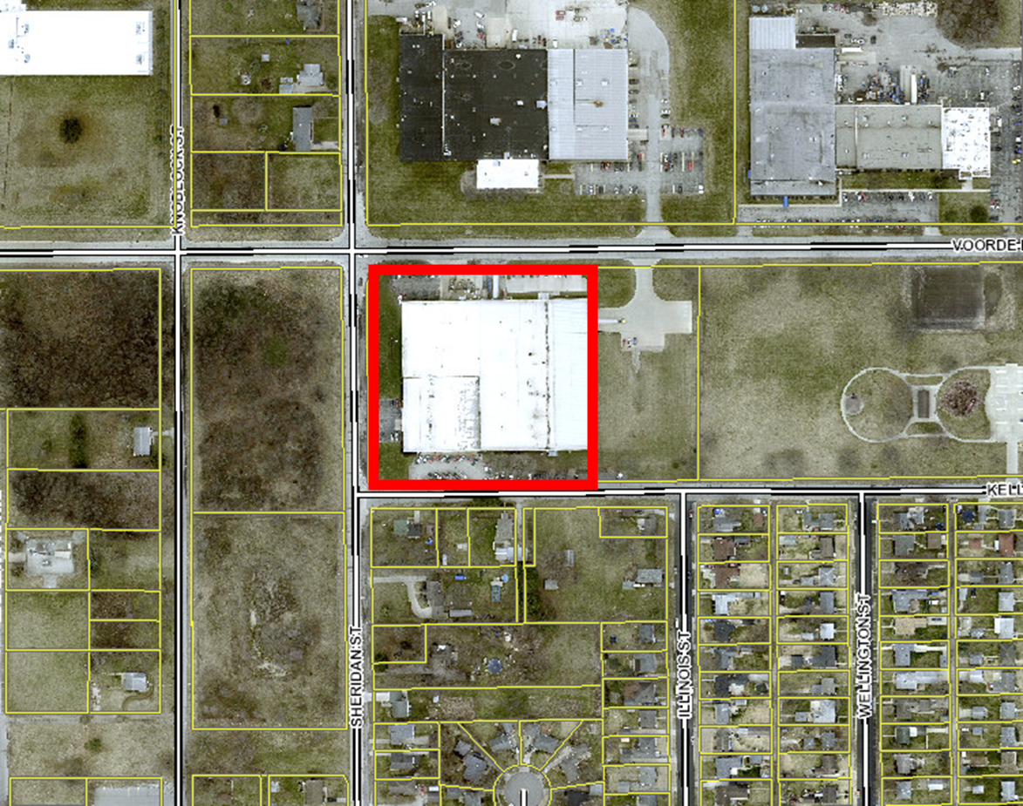
Five (5) year Personal Property Tax Abatement
1710 North Sheridan St. for Hoosier Tank & Manufacturing, LLC

Slide 4
Confirming Resolution: Bill No. 24-28
Tax Abatement for
Hoosier Tank & Manufacturing, LLC
Personal Property Abatement
  New Personal Property will be owned & operated by Hoosier Tank & Manufacturing, LLC
  Operating in South Bend since 1991
  New equipment and facility improvements will expand production capacity
  Will hire 15 new employees, and retain 112 current employees
  Total local investment: $4,000,000

Slide 5
Confirming Resolution: Bill No. 24-28
Tax Abatement for
Hoosier Tank & Manufacturing, LLC
Personal Property Abatement
Tax summary
  Personal Property taxes paid in most recent tax year: $89,941.16
  Estimated additional taxes in the first year after installation: $54,144.00
    Current assessed value: $3,037,010
    Estimated assessed value after project: $4,634,010
  During the 5-year abatement:
    New estimated taxes: $320,803
    Portion of new taxes abated: $227,956
    Portion of new taxes paid: $92,847
  During the 5-year period following the abatement:
    New taxes paid: $139,421

Slide 6
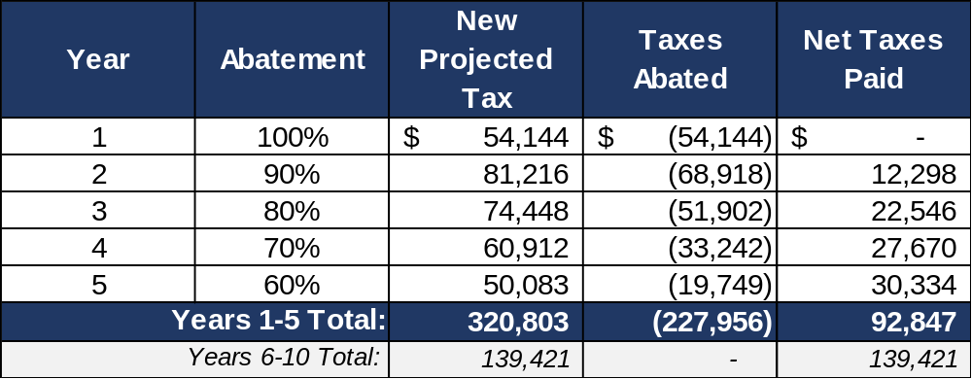
Confirming Resolution: Bill No. 24-28
Tax Abatement for Personal Property belonging to Hoosier Tank & Manufacturing, LLC
ESTIMATED* New Taxes During Abatement Period
* Assumes constant tax rates and no changes in assessed value.

