Slide 1

Center for Innovation and Entrepreneurship - IUSB
Rob DeCleene
March 26, 2024

Slide 2
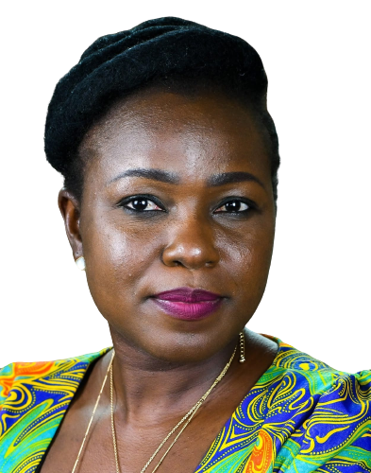
Founding Director
Modupe Adeoye serves as the director of innovation and entrepreneurship for IU South Bend (IUSB). With a decade of experience in leading significant projects across multiple sectors.
Modupe is passionate about fostering a culture of creativity and growth, empowering aspiring entrepreneurs, and driving impactful collaborations.

Slide 3
CENTER GOALS
Goals of the CIE: Connect. Inspire. Engage
          Fostering a culture of innovation and entrepreneurship on campus.
          Developing and implementing programs to support students and the community in entrepreneurship.
          Promoting interdisciplinary collaboration and engagement with the business community such as the North Central Indiana Small Business Development Center (ISBDC), Idea Center, and Ignition Park.
          Creating opportunities for experiential learning and skill development.

Slide 4
PROGRAMS
K-12 launch pad
The "K-12 launchpad" initiative aims to create a transformative educational experience for high school students in our community. By establishing a business incubator for high schoolers, we will provide a unique platform for young minds to explore entrepreneurship, innovation, and STEM education while preparing them for future success in the entrepreneurial world.
Entrepreneurship Student Ambassadors Program
The Entrepreneurship Student Ambassadors (ESA) program aims to cultivate a community of enthusiastic and knowledgeable student ambassadors to promote entrepreneurial thinking, innovation, and venture creation. The network of student ambassadors will support fellow students in their entrepreneurial journeys.
Entrepreneurship Certificate Program
To provide students at Indiana University South Bend (IUSB) with comprehensive learning in entrepreneurship, emphasizing hands-on experience, practical knowledge, and innovative thinking.

Slide 5
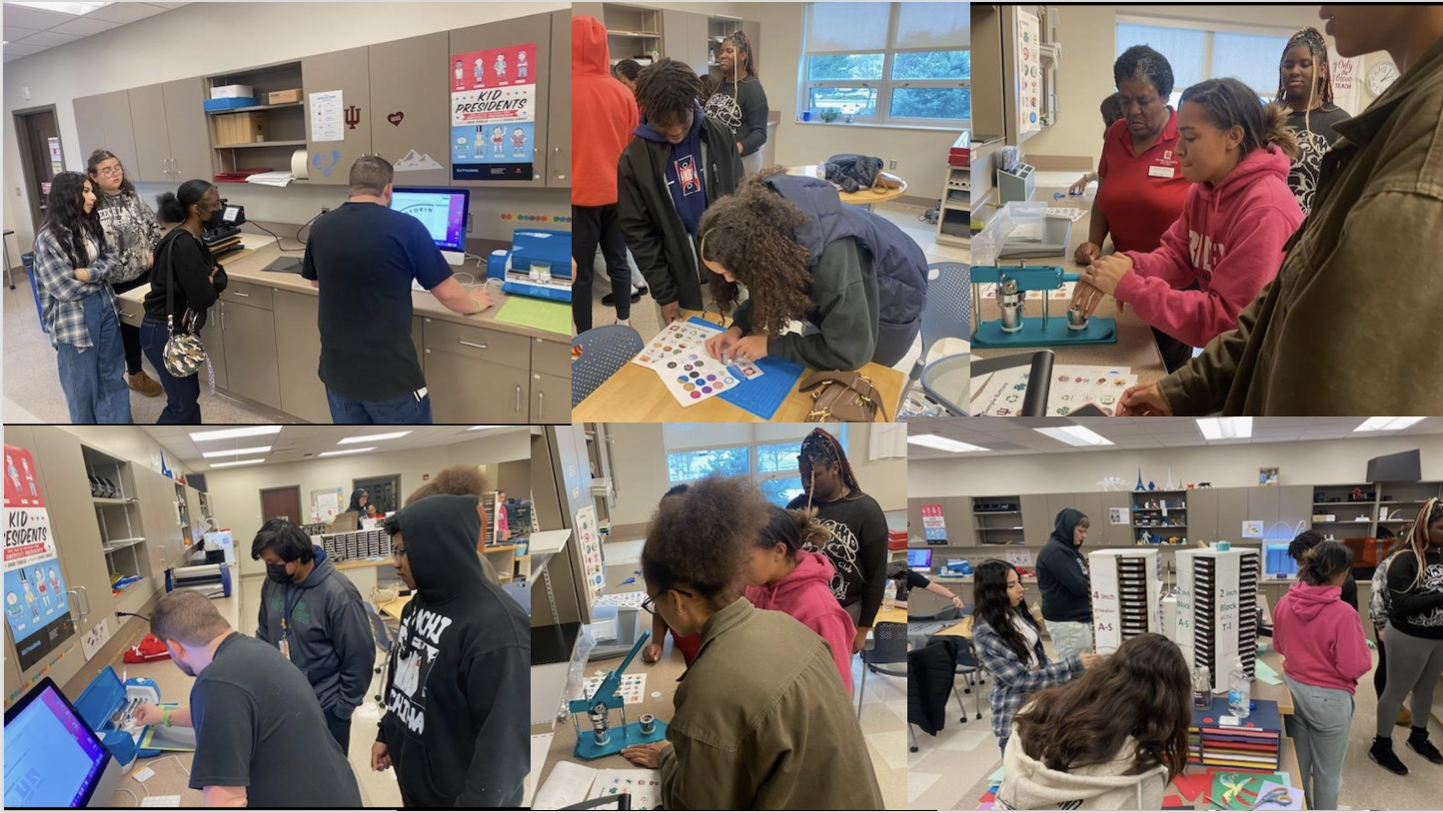

Slide 6
Community
Community engagement opportunities:
Workshop Facilitators: Offer to lead innovation and business workshops or seminars that share your insights and expertise with students.
Mentorship: Your mentorship to select IUSB students, can help them make informed decisions and navigate challenges effectively.
Internship/Job Shadowing: Allow students to shadow professionals in your field and get hands-on experiences in a safe environment. This experience can help them gain a better understanding of their chosen career paths.
Notes:
Right now, we have only one simulation laboratory. In the new space we are going to have four simulation rooms that will be controlled from a central location
For radiography students, we are going to have an energized lab that we do not have now

Slide 7
QUESTIONS?

Slide 8
2024 UEDA SUMMIT
UNIVERSITY ECONOMIC DEVELOPMENT ASSOCIATION
Embassy Suites – SB
October 6-9, 2024

Slide 9


