Slide 1
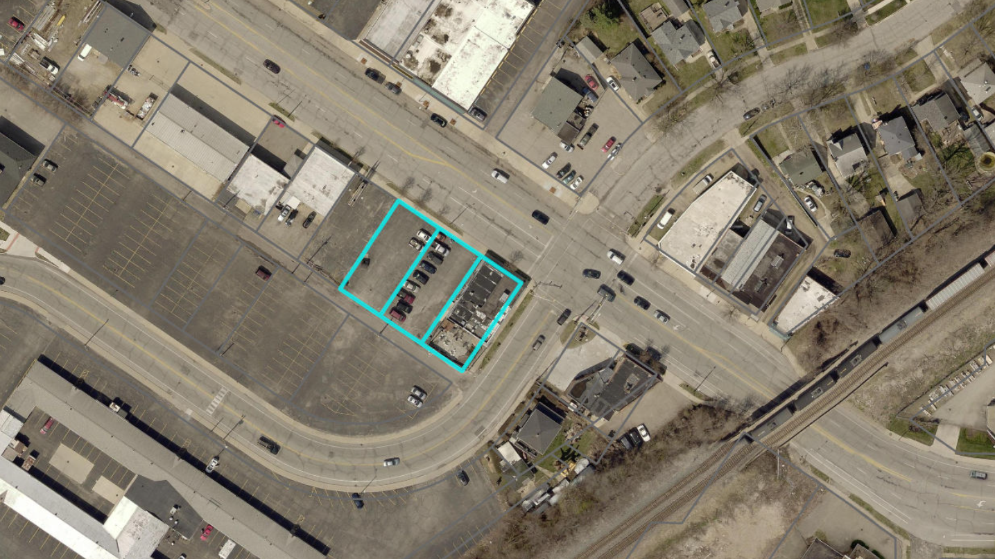

Slide 2
Kelly’s Pub
December 2023, after a shooting at the pub, neighbors organized a meeting between the nearby neighborhood, Mr. Kelly, and City officials/police
Mr. Kelly indicated he would be willing to sell, and had been attempting to do so for some time
City staff began negotiations with Mr. Kelly

Slide 3
Resolution to Purchase
Kelly’s Pub
Authorizes the Board of Public Works to purchase all three lots
Negotiated purchase price of $275,000.00
  Under the average of two independent appraisals per state law
If approved – pub operations would cease on March 26th
City take possession early April
City would intend to demolish building and better secure parking lots in interim

Slide 4
Reasons for Purchase
The pub has been a long term neighborhood concern
  In 2019, mass shooting killed one and injured 11 others
  Since 2021, at least 80 police calls of service to the pub
  Two shootings a month apart recently
Closing the pub would significantly improve the safety of the surrounding area and city overall
Many neighborhood bars across SB are additive, Kelly’s has not been

Slide 5
Reasons for Purchase
Property has been up for sale. City’s purchase allows for the City to control future of property.
Surrounding area has seen business growth – Oh Mamma’s, Cloud Walking, Ironhand Winery, the Armory, etc. – would be a prime site for redevelopment.
City is planning improvements to Mishawaka Ave and overall “Market District”, control of property would be beneficial during that process.

Slide 6
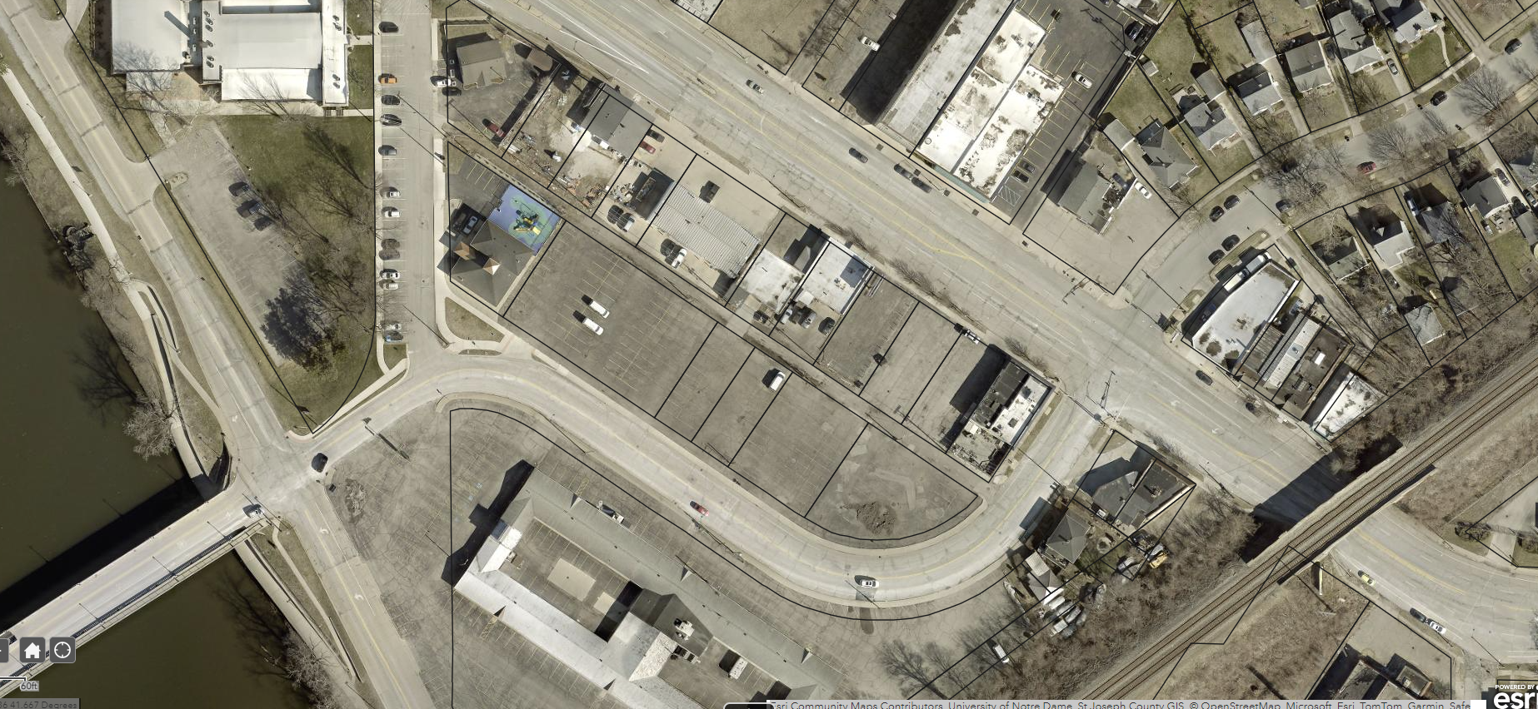

Slide 7
Next Steps
If approved by Council, BPW would vote on Tuesday March 12th on Purchase Agreement
Bar operations cease on March 26th
Closing in April
City would secure building and parking lots, begin process for redevelopment of the site
  Already reached out to neighboring businesses to be good neighbors
Mishawaka Ave. and intersection improvements tentatively in 2025

