Slide 1


Presentation to South Bend Common Council
Improving the ROW Vacation Process
March 11, 2024
Notes:
TC

Slide 2
Topics
  Concerns with current vacation process / ordinance
Proposed improvements to the vacation process/ ordinance
Next Steps
Notes:
TC

Slide 3
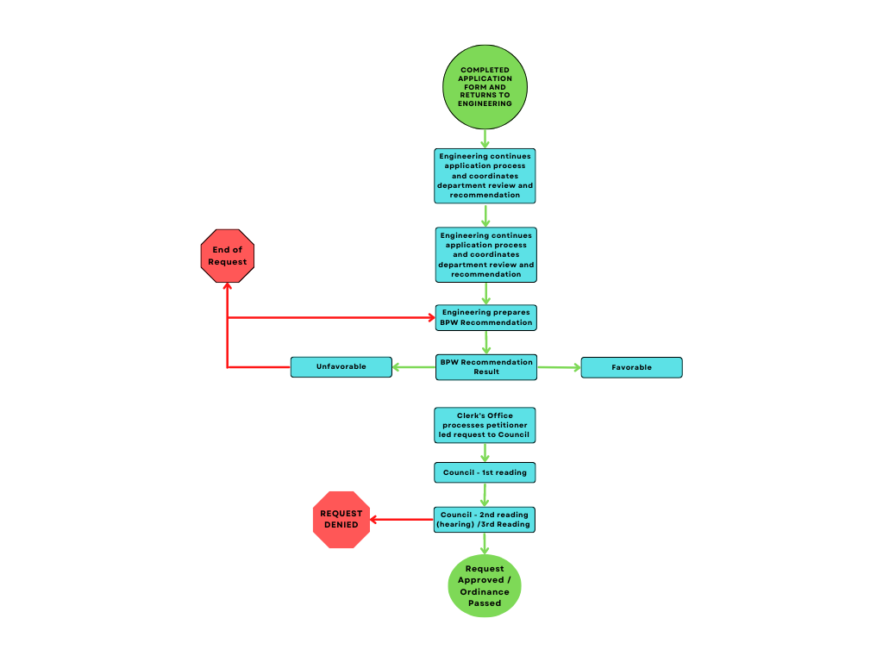
Current Process
Notes:
CD

Slide 4
Current Process
Applicants lack guidance
Errant referrals suggesting vacation is solution
Notes:
CD

Slide 5
Current Process
Applicants lack guidance
Errant referrals suggesting vacation is solution
No proper recommendation criteria
Notes:
CD

Slide 6

Current Process
Applicants lack guidance
Errant referrals suggesting vacation is solution
No proper recommendation criteria
Requests do not expire following BPW result and sometimes are amended from original request.
Notes:
CD

Slide 7
Current Process
Notes:
CD

Slide 8
Current Process
Applicants responsible for completing the ordinance, including legal description
Notes:
CD

Slide 9
Current Process
Applicants responsible for completing the ordinance, including legal description.
Notifications to property owners may fail to cover the full block beyond the 150 ft radius.
Only one signature required from affected property owners.
Notes:
CD

Slide 10

Current Process
Applicants responsible for completing the ordinance, including legal description
Notifications to property owners may fail to cover the full block beyond the 150 ft radius
Only one signature required from affected property owners
Lack of notification to all relevant city departments and agencies in advance of petition filing
Notes:
CD

Slide 11
Current Process
Applicants responsible for completing the ordinance, including legal description
Notifications to property owners may fail to cover the full block beyond the 150 ft radius
Only one signature required from affected property owners
Lack of notification to all relevant city departments and agencies in advance of petition filing
Lack of staff monitoring during the public meeting/hearing process
Notes:
CD

Slide 12
Current Process
Applicants responsible for completing the ordinance, including legal description
Notifications to property owners may fail to cover the full block beyond the 150 ft radius
Only one signature required from affected property owners
Lack of notification to all relevant city departments and agencies in advance of petition filing
Lack of staff monitoring during the public meeting/hearing process
Lack of notification to all relevant city departments following decision
Notes:
CD

Slide 13
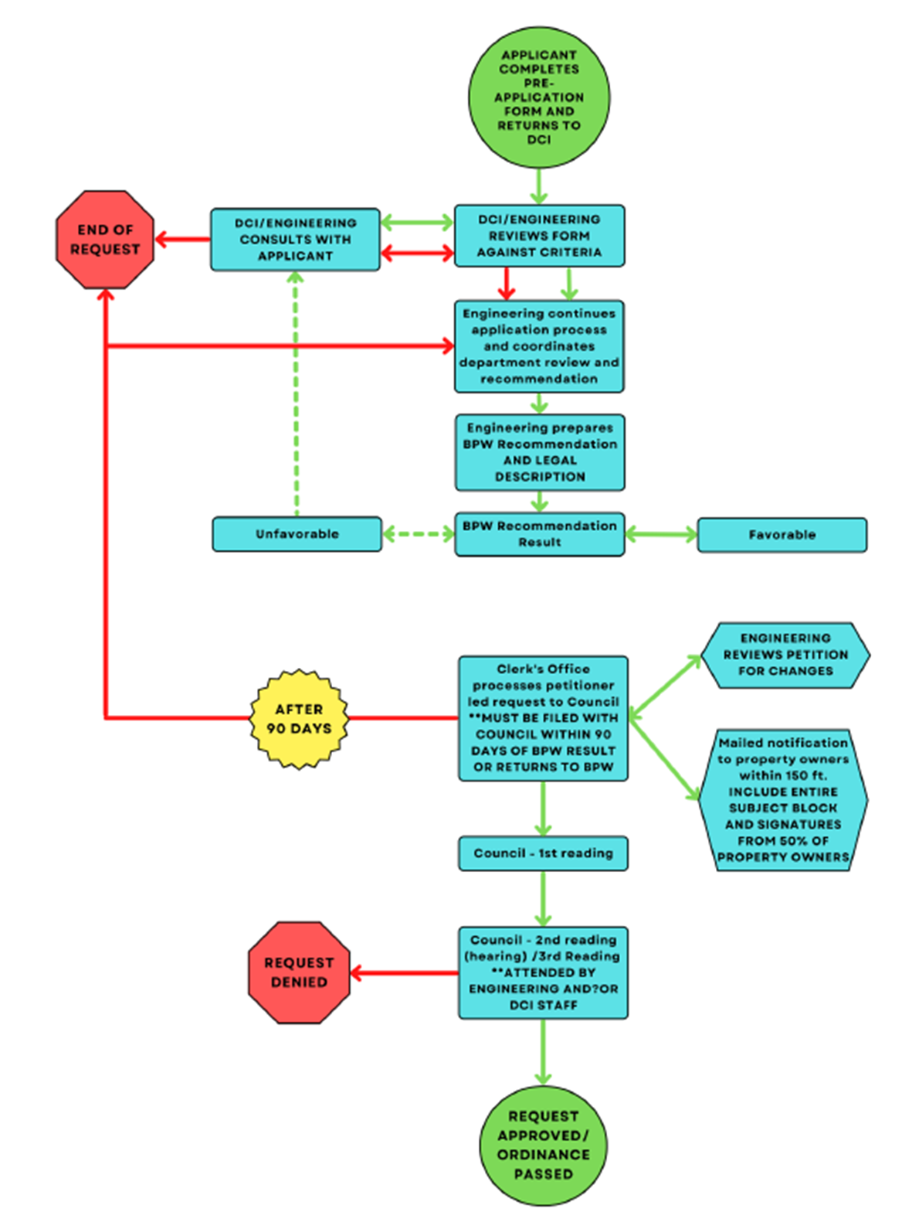
Proposed Process
Notes:
CD

Slide 14
Proposed Process
Alleys 101
New intake/engagement improves consultation with applicants/petitioners and the quality of requests
Notes:
CD

Slide 15
Proposed Process
Alleys 101
New intake/engagement improves consultation with applicants/petitioners and the quality of requests
Board of Public Works sets evaluation criteria for vacation requests
Notes:
CD

Slide 16
Proposed Process
Alleys 101
New intake/engagement improves consultation with applicants/petitioners and the quality of requests
Board of Public Works sets evaluation criteria for vacation requests
Process Unchanged
Notes:
CD

Slide 17
Proposed Process
Notes:
CD

Slide 18

Proposed Process
Streamline petition process through accuracy of content and more efficient notification
Notes:
CD

Slide 19
Proposed Process
90-day limit between BPW result and petition filing
Streamline petition process through accuracy of content and more efficient notification
Notes:
CD

Slide 20
Proposed Process
90-day limit between BPW result and petition filing
Streamline petition process through accuracy of content and more efficient notification
City staff attends council hearings where petitions are taking place
Notes:
CD

Slide 21
Proposed Process
90-day limit between BPW result and petition filing
Streamline petition process through accuracy of content and more efficient notification
City staff attends council hearings where petitions are taking place
City departments are notified of result
Notes:
CD

Slide 22
Summary of Proposal
Provide additional guidance to applicants/petitioners (Alleys 101)
Improve quality of requests
Use Pre-Application form/engagement process
Add appropriate evaluation criteria as defined by Board of Public Works (BPW)
Update language to reflect changes to criteria, process, and responsibilities
Set a 90-expiration date for petition requests following BPW review
Provide further assistance to petitioners with filing requirements
Accompany/attend requests through the public hearing process
Notes:
TC / CD

Slide 23
Next Steps
Update to Board of Public Works
Present to Common Council for ordinance adoption
Conclude with Board of Public Works for policy / criteria
Prepare materials and content / assign roles, and responsibilities
Effective Date Launch
Notes:
TC / CD

Slide 24
Questions?
Notes:
TC / CD

