Slide 1

South Bend
Common Council
November 27, 2023

Slide 2
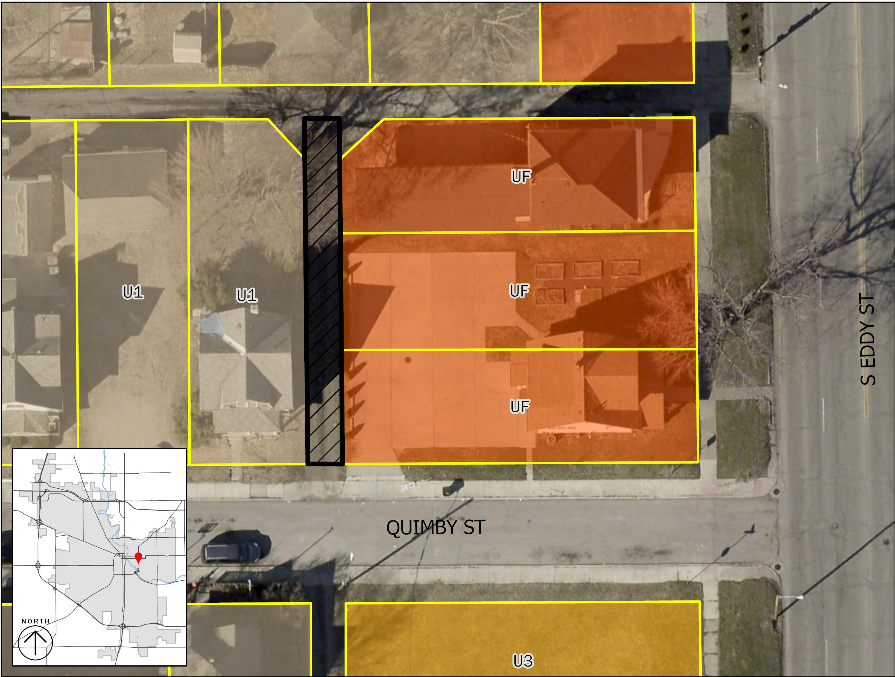
1023 Quimby St

Slide 3
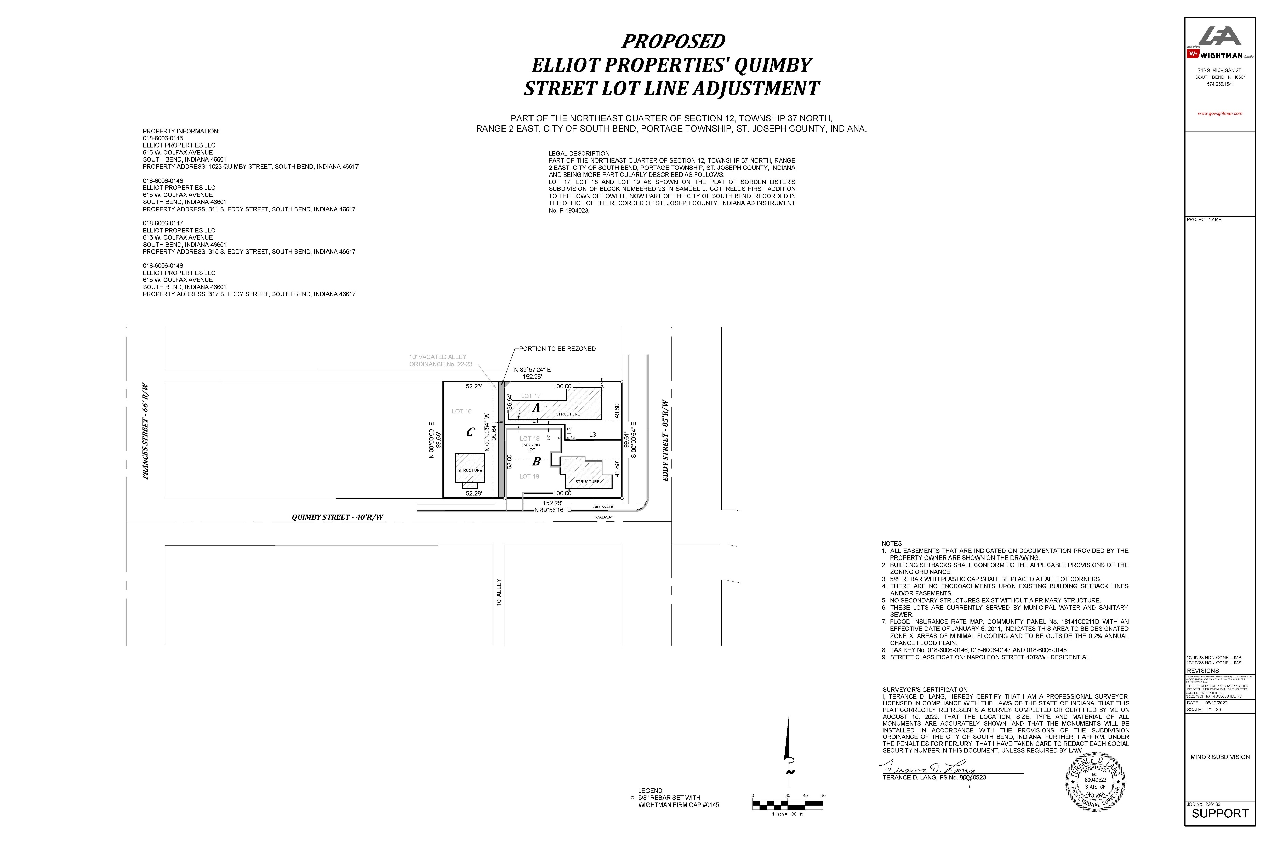

Slide 4
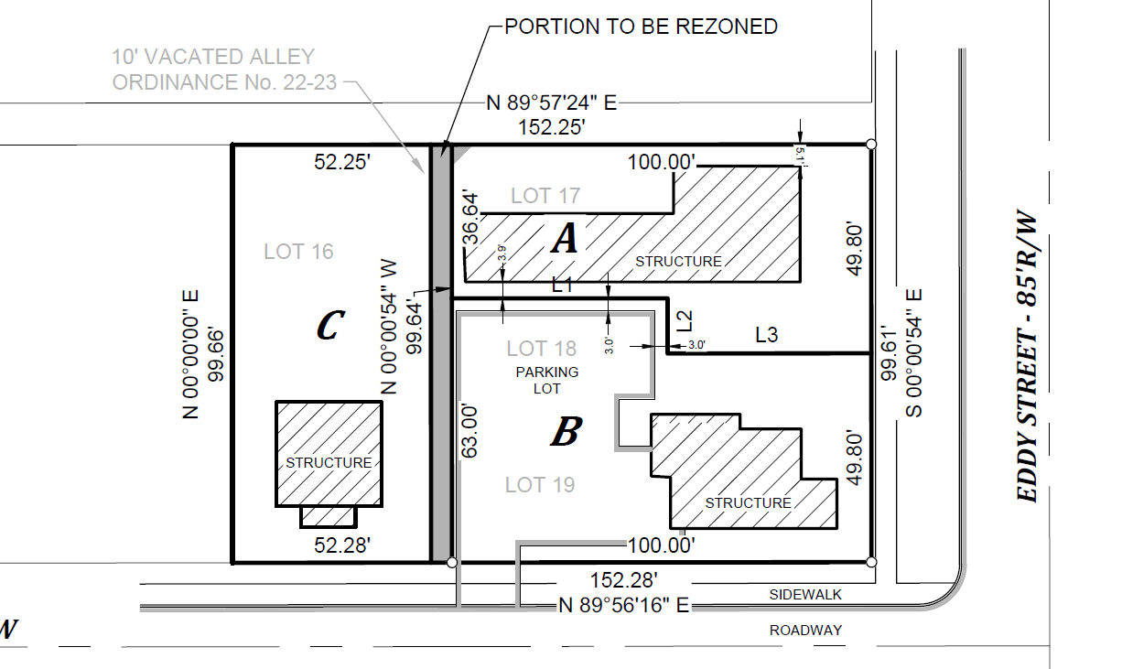

Slide 6
U1
UF

Slide 7
U1
UF

Slide 8
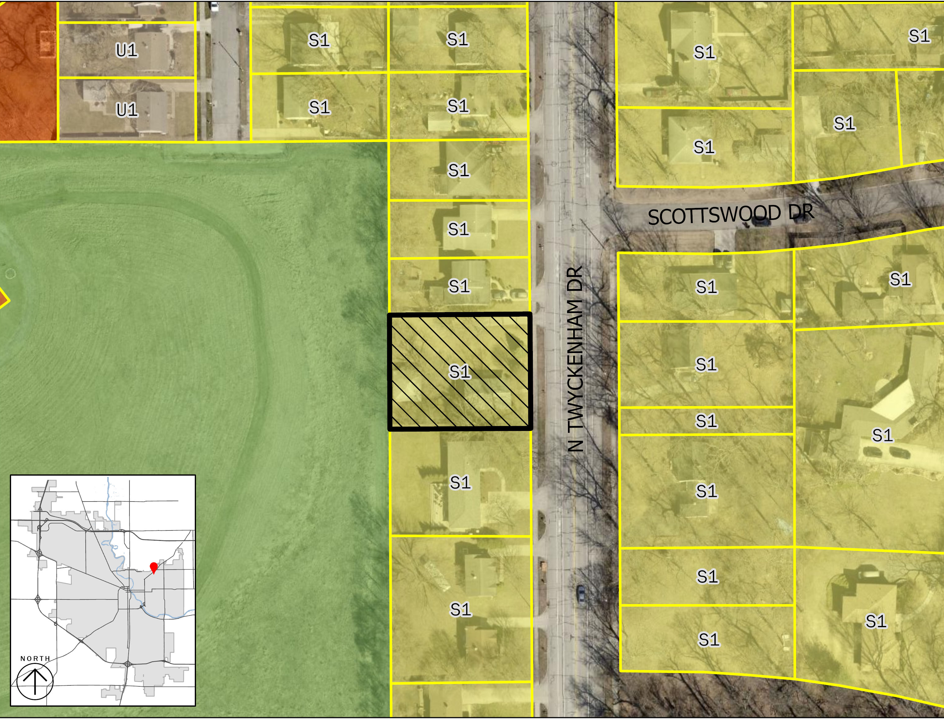
1119 Twyckenham

Slide 9

1119 Twyckenham

Slide 10
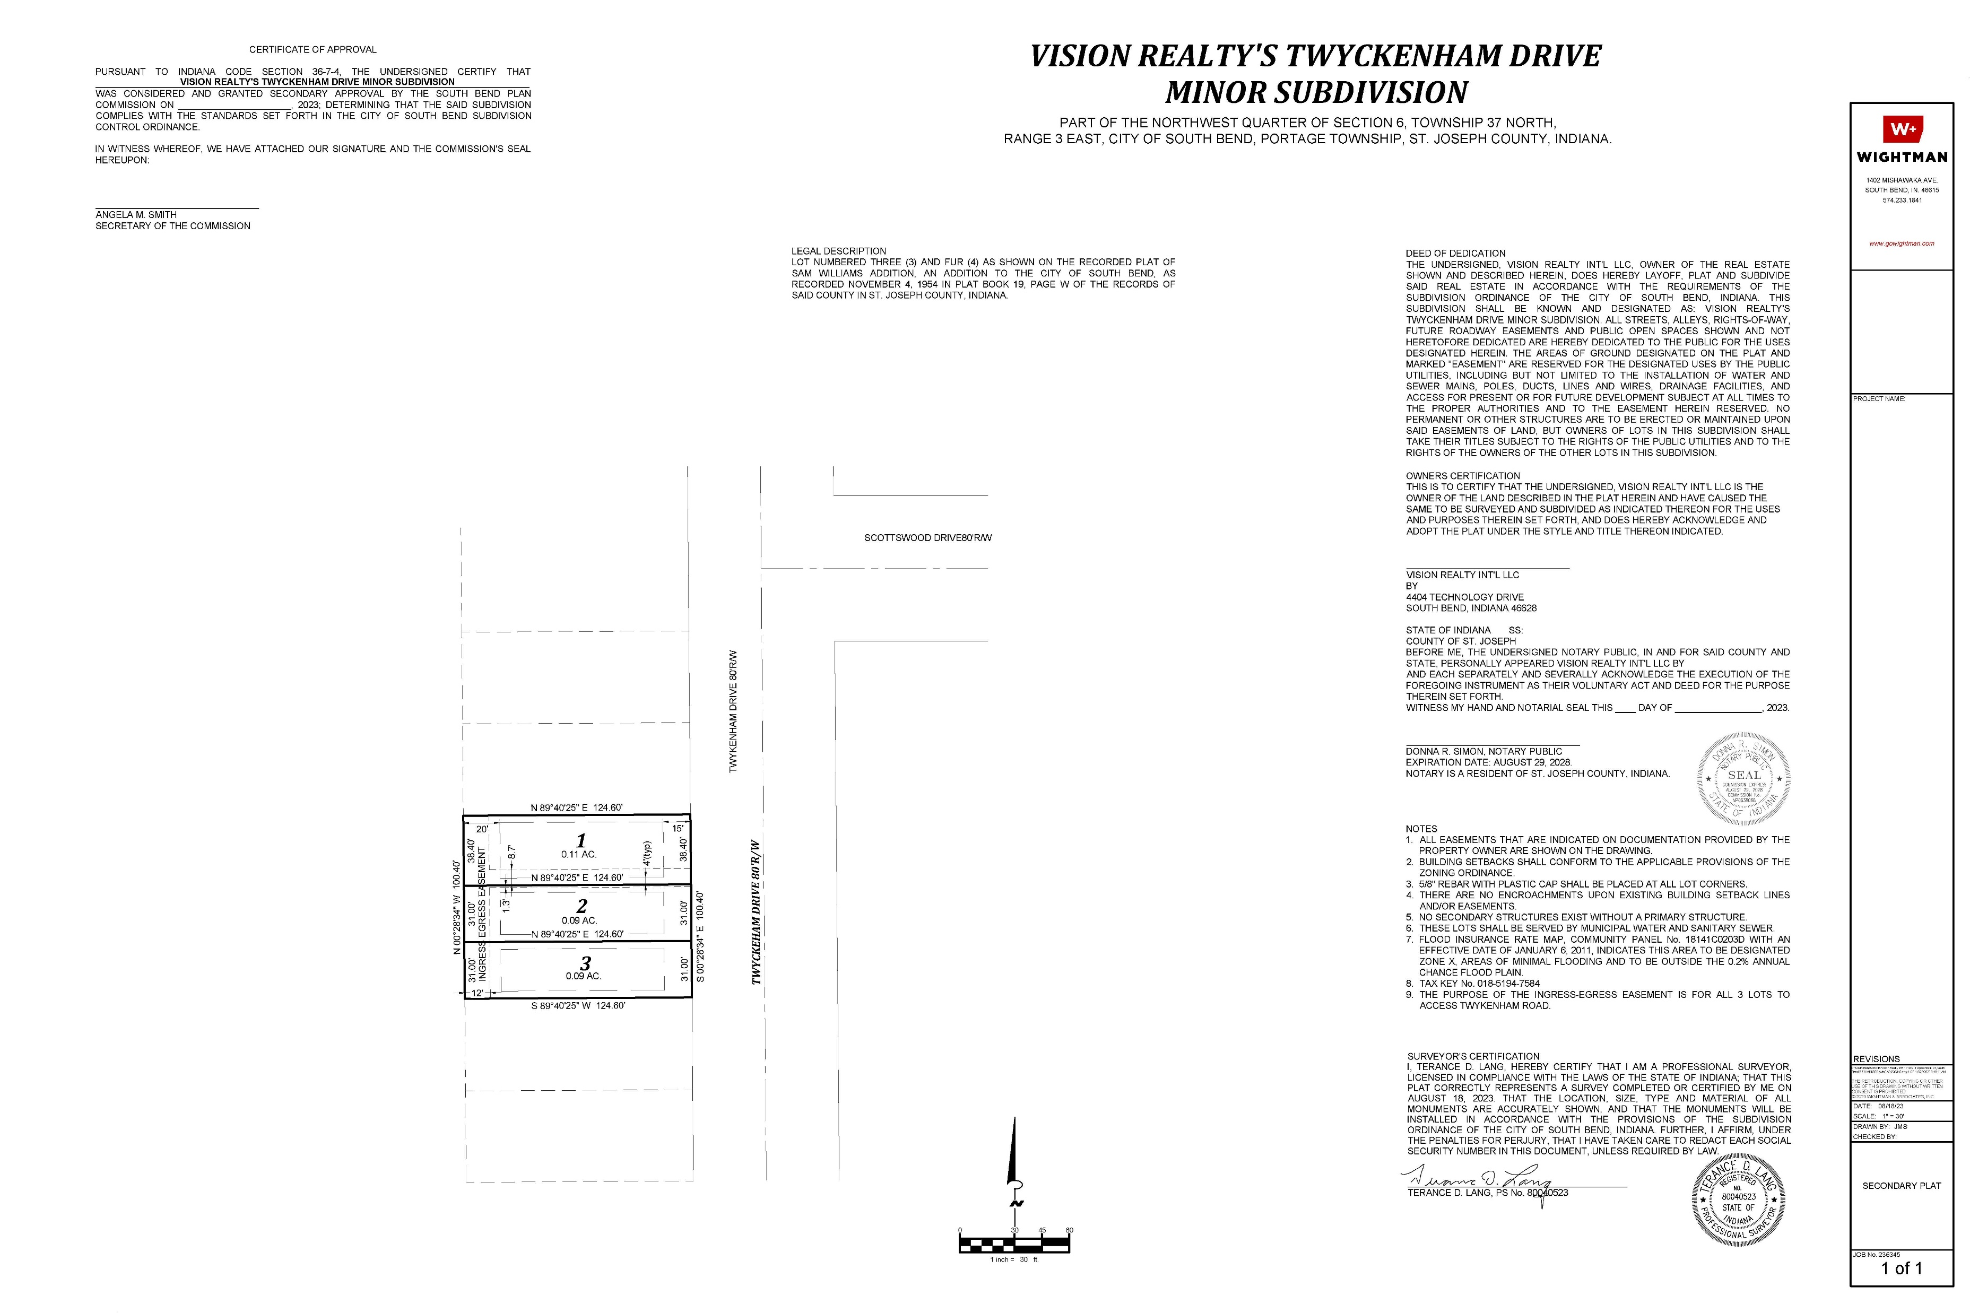

Slide 11
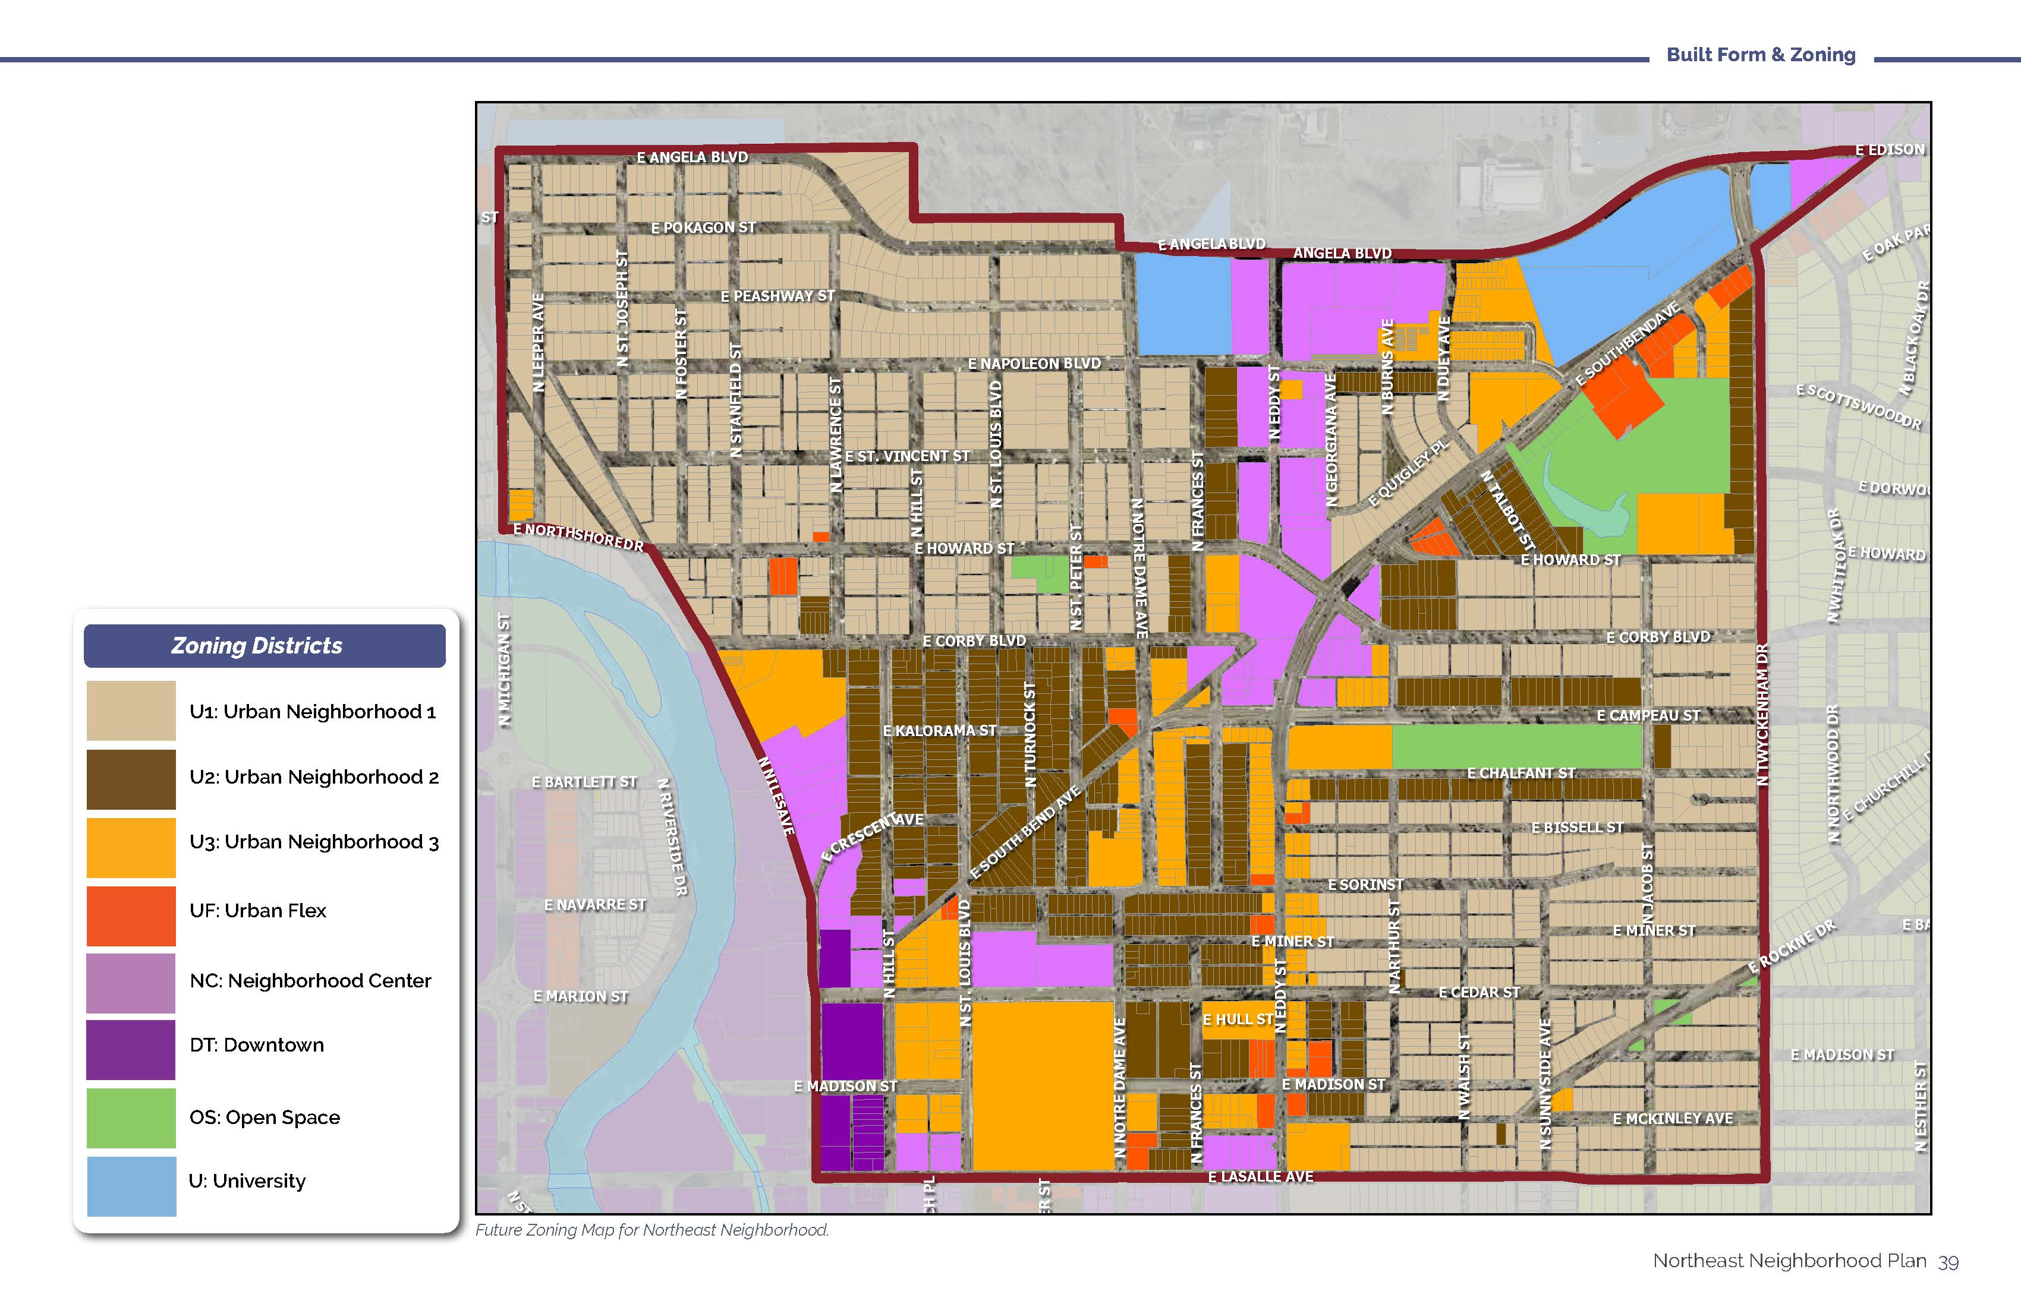

Slide 12
