Slide 1
Department of Community Investment
October 27, 2022

Slide 2
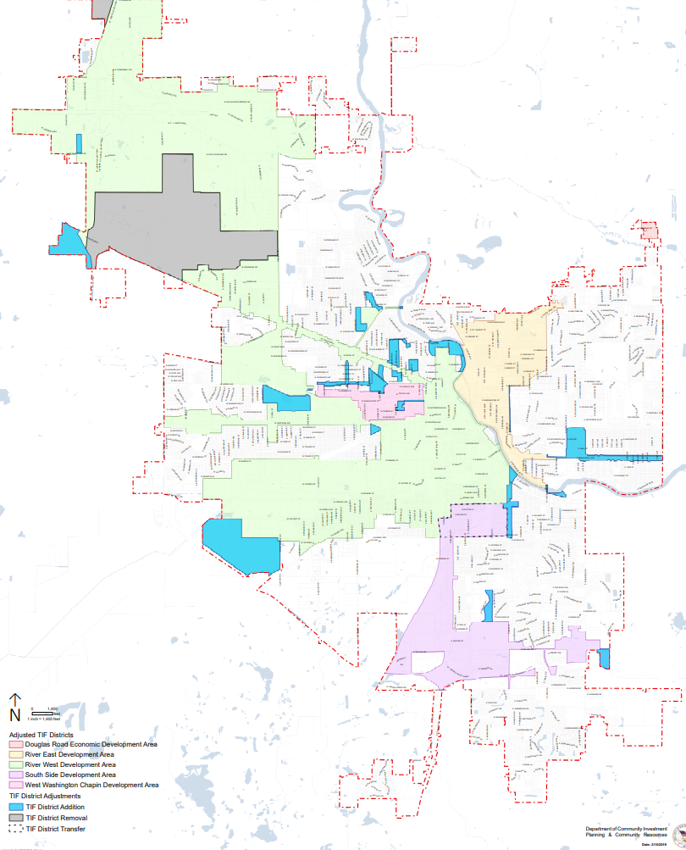
Redevelopment Funds
324 - River West TIF District
422 – West Washington TIF District
429, 436 – River East TIF District
430 – South Side TIF District
433 – Redevelopment Admin/Pokagon Fund
435 – Douglas Road TIF District

Slide 4
REDEVELOPMENT FUNDS (INFORMATIONAL)
Major Upcoming/Ongoing Projects
More than $2 M match to support 4 IHCDA Low Income Housing Tax Credits applications (award announcements in November)
$300,000 to support Ward Bakery adaptive re-use on Portage Avenue (along with support from Revolving Loan Fund)
$1.4 M to support United Way Southeast Center
$4.5 M for Rebuilding Our Streets initiative
$500,000 to support Pure Green Farms $30 million greenhouse facility and Phase II
$500,000 for scattered site Permanent Supportive Housing match
$500,000 set aside for south side neighborhood park
$3 M for Fire Station #8 renovation

Slide 5
OPPORTUNITIES
READI
  Focused on maximizing impact of $50 million awarded to South Bend-Elkhart Region by the IEDC
  Awards announced Sept. 19
  Beacon Integrative Health and Lifestyle District & Memorial Tower Expansion - $400+ million investment, 550 FTEs, structured parking needs, 240 housing units, hotel, health & fitness center, office, retail
Hotel/Motel
  New trail opportunities
Federal opportunities
  Reconnecting Our Communities Grant Application
  RAISE Grant
  EV Charging Infrastructure Grant
Neighborhood Plan Implementation

Slide 6
2023 GOALS
Continue focus on New Neighborhood Housing initiative to minimize appraisal gap and move more vacant lots to constructive uses
Implementation of NWS, NE, Kennedy Park, and Rum Village plans
Improve resident engagement on City services and direct neighborhood association support
Increase meaningful information available on City services, including better accessibility of information online (e.g. city property database)
Continue to pilot economic empowerment programs
Expand workforce development programming and build connections with other organizations and agencies to understand holistic workforce development landscape
Increase financing for small businesses
Promote greater density within the urban core and surrounding neighborhoods
Maximize impact of READI, state, and federal grant opportunities

