Slide 1
South Bend Common Council
2022 Proposed Budget
Thursday, September 30, 2021

Slide 2

Common Council Members & The Districts They Represent
South Bend Common Council
Districts
First District - Councilman Canneth Lee Second District – Councilman Henry Davis, Jr.
Third District – Councilwoman Sharon McBride Fourth District – Councilman Troy Warner
Fifth District – Councilman Eli Wax Sixth District – Councilwoman Shelia Niezgodski
At Large
Councilwoman Lori Hamann
Councilwoman Rachel Tomas Morgan
Councilwoman Karen L. White
Bob Palmer, Attorney

Slide 3
2021 Council Budget at a Glance

Slide 4

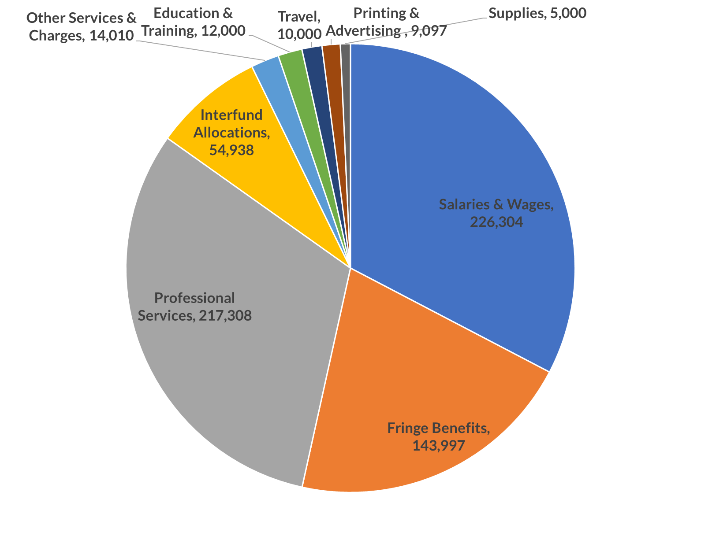
South Bend Common Council
City of South Bend Common Council 2021 Budget Expenditures Summary
Category |  | 2021 Proposed Budget |  | 2021 Percent of Total
Salaries & Wages |  | 226,304 |  | 32.61%
Fringe Benefits |  | 143,997 |  | 20.75%
Professional Services |  | 217,308 |  | 31.32%
Interfund Allocations |  | 54,938 |  | 7.92%
Other Services & Charges |  | 14,010 |  | 2.02%
Education & Training |  | 12,000 |  | 1.73%
Travel |  | 10,000 |  | 1.44%
Printing & Advertising |  | 9,097 |  | 1.31%
Supplies |  | 5,000 |  | 0.72%
Repairs & Maintenance |  | 1,255 |  | 0.18%
Total Expenditures by Type |  | 693,909 |  | 100.00%

Slide 5
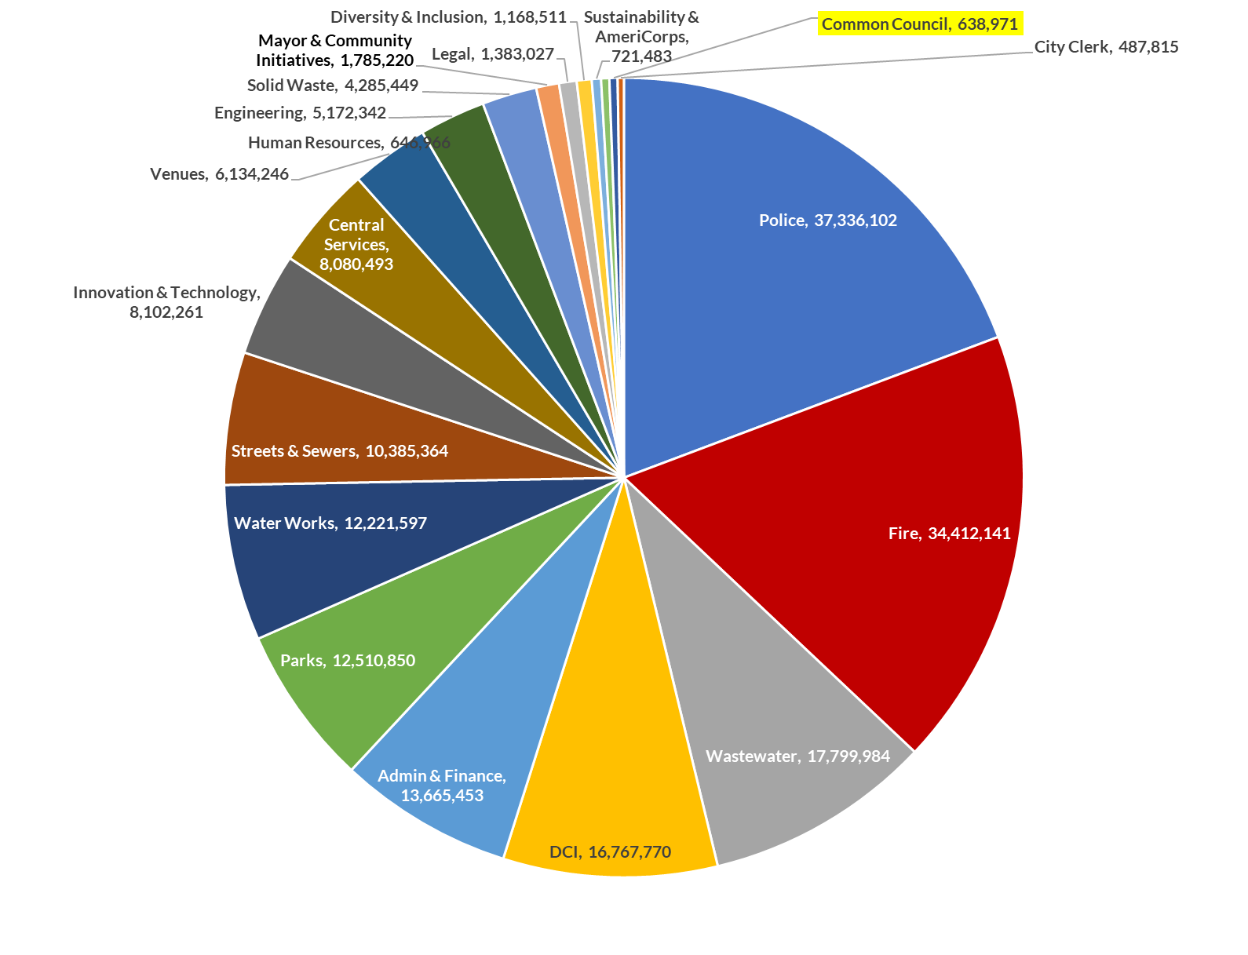
South Bend Common Council
City of South Bend 2021 Proposed Budget Expenditure Summary Personnel, Supplies, & Services by Department
Category |  | 2021 Proposed Budget |  | 2021 Percent of Total
Police |  | 37,336,102 |  | 19.28%
Fire |  | 34,412,141 |  | 17.77%
Sewage Works |  | 17,799,984 |  | 9.19%
DCI |  | 16,767,770 |  | 8.66%
Admin & Finance |  | 13,665,453 |  | 7.06%
Parks |  | 12,510,850 |  | 6.46%
Water Works |  | 12,221,597 |  | 6.31%
Streets & Sewers |  | 10,385,364 |  | 5.36%
Innovation & Technology |  | 8,102,261 |  | 4.18%
Central Services |  | 8,080,493 |  | 4.17%
Venues |  | 6,134,246 |  | 3.17%
Engineering |  | 5,172,342 |  | 2.67%
Solid Waste |  | 4,285,449 |  | 2.21%
Mayor & Community Initiatives |  | 1,785,220 |  | 0.92%
Legal |  | 1,383,027 |  | 0.71%
Diversity & Inclusion |  | 1,168,511 |  | 0.60%
Sustainability & AmeriCorps |  | 721,483 |  | 0.37%
Human Resources |  | 646,966 |  | 0.33%
Common Council |  | 638,971 |  | 0.33%
City Clerk |  | 487,815 |  | 0.25%
Total Expenditures by Type |  | 193,706,045 |  | 100%

Slide 6
Individual Common Council 2022 Budget Discussion Points
South Bend Common Council
Council’s budget discussions:
  A need to have a plan and timeframes for addressing our challenging neighborhoods.
  A sustainable plan to address our homeless citizens.
  A clear picture/plan as to how the American Rescue Funds will be used.
  The current Federal dollars that the City has received is only temporary, we must be very intentional about the spending.
  Performance Based Budgeting.
  Smart Cities Build Back: Better and Smarter in a Post-COVID World.
  New positions must align with budget priorities and must be supported with a strong rationale and evidence of department performance.
  The ARP funds will allow us to create some very transformative changes or projects. There will be a pushed to use this money to supplement our current budget gap. Some of these funds could be used for routine city expenses, but they may not get the city the best buck for its ARP.
  Districts representative would like to know how the budget will support their constituents in their districts.
  Need to get closer to a balanced long -term budget.
  We must be intentional and strategic in planning for the future. It will take everyone working together and at the table to ensure the sustainability for planning for the future with a common goal in mind.

Slide 7
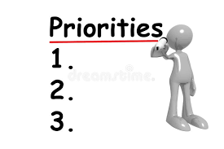
Common Individual Council 2022 Budget
Priorities
Economic Development Priorities
Build back the economic: By investing in infrastructure to generate good paying jobs to spur economic growth and post-COVID economic recovery.
Additional Start Up Business: Specific programs and support for Minority Businesses
Invest in wages and skills development to retain talent in city work force all levels
Train a green workforce generation (repair aging water & sewer systems, solar systems, lighting, roads traffic lighting, roads sidewalks, etc.
Education
Create opportunities for public/private partnerships and incentives for hiring/training South bend high school graduates for high paying jobs.
Build back for our children: Expand support to high quality affordable childcare, pre-K and early childhood education.

Slide 8
Individual Common Council
2022 Budget Priorities
Infrastructure – Neighborhoods and City Wide
Increase Street Paving & Curbs, Sidewalks and Lighting.
Increase the Council’s Allotment for curbs and sidewalks.
Investments in aging infrastructure with basic city services.
Many of our homes are now approaching 70-100 years old and basement qualities have drastically deteriorated. over the past decade, worsened by the increase of massive rain events and climate changes.
More resources to keep the city clean and tidy, hire the challenged employed as subcontractors to mow and trim alley ways, clean up trash, and trim the public right of ways of the city.
Tie infrastructure investment with a climate change resilient/sustainability/green agenda to economy.
Public Safety
Provide assistance to SBPD to assist in recruiting and retention. Resume proactive policing measures such as the drug task force, and the traffic bureau.

Slide 9
Individual Common Council 2022 Budget Priorities
Continued
Public Safety
More traffic calming and the return of the traffic bureau.
Identify ways to reduce speeding (more money for traffic enforcement and type of new high- tech options for traffic enforcement even it if does not result in a citation)
Creative uses to reduce the need for SBPD to respond to the board array of calls they do and to increase the numbers of officers and recruits for SBPD.
Housing
Affordable Housing, Housing for our Homeless Citizens, Expand the area for the Residential Home Repair program; Support or incentivize new housing construction in vacant lots in distressed neighborhoods; support for mixed income housing development
Neighborhoods Plans
Plan for Indiana Avenue, Revisit the plans for the Park that was in the Original Western Avenue Main Streets plan South Side of Western in the 6th District.

Slide 10
Individual
Common Council 2022 Budget Priorities
Continued
Parks & Green Spaces
Creation of the City’s First Park in the 5th District.
Outdoor stage and restrooms for Charles Black Center.
New Center for the current Martin Luther King Jr. Center.
Completion of Randolph Park in the 3rd District.
Update Rum Village Community Center.
Revisit the plans for the Park that was in the original Western Avenue/Main Street Plan.
Additional spending for recreation and parks to aid in addressing the youth violence issue in SB.

Slide 11
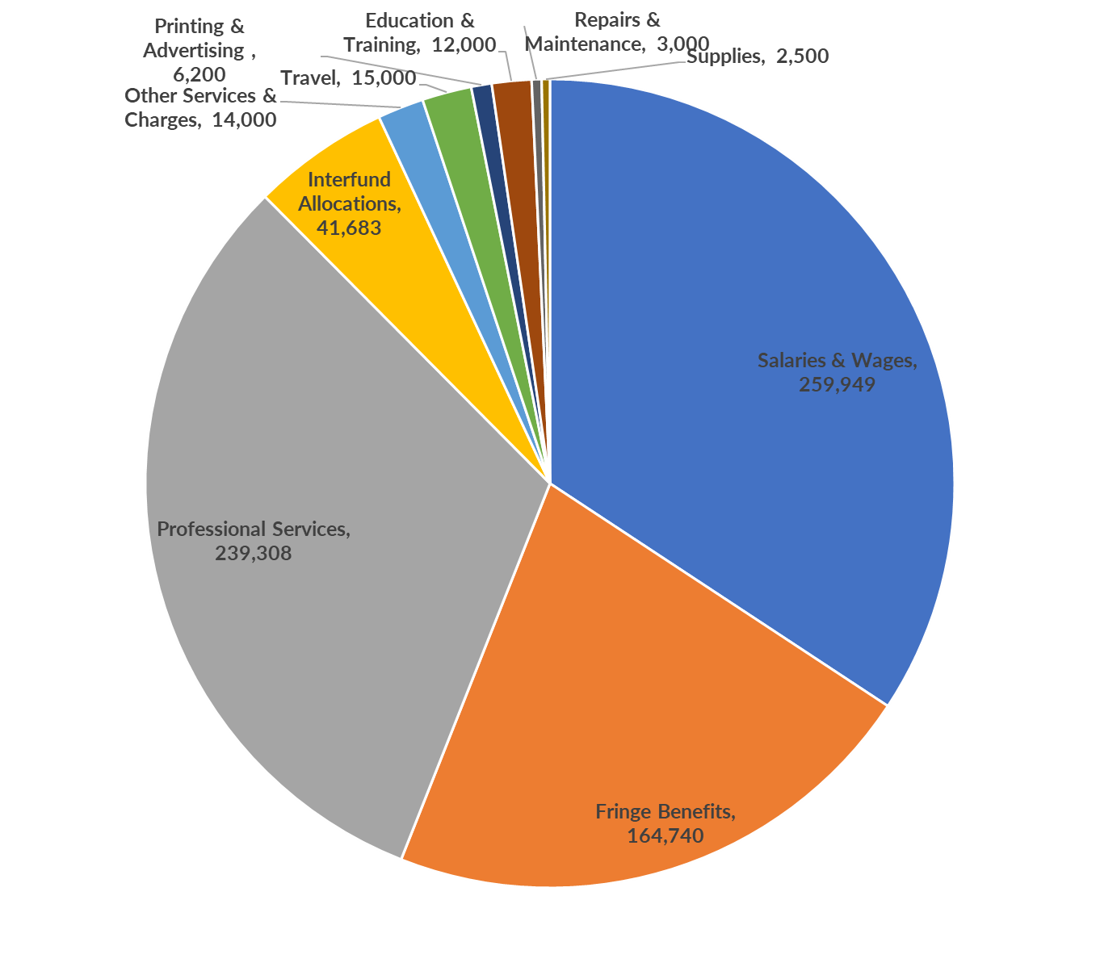
Category |  | 2021 Budget |  | 2022 Proposed Budget
Salaries & Wages |  | 226,304 |  | 259,949
Fringe Benefits |  | 143,997 |  | 164,740
Professional Services |  | 217,308 |  | 239,308
Interfund Allocations |  | 54,938 |  | 41,683
Other Services & Charges |  | 14,010 |  | 14,000
Travel |  | 10,000 |  | 15,000
Printing & Advertising |  | 9,097 |  | 6,200
Education & Training |  | 12,000 |  | 12,000
Repairs & Maintenance |  | 1,255 |  | 3,000
Supplies |  | 5,000 |  | 2,500
Total Expenditures by Type |  | 693,909 |  | 758,380
Requests
1. Part Time Legal Assistant
Return to 2020 Travel Allotment
Part-time Administrative Assistant
Proposed Salary Increase 2%

Slide 12
Individual Common Council Members 2021 -2022
Goals
Successful Implementation of the Community Police Review Board.
The appointment of the Redistricting Committee. (October 2021).
Review of the Quality-of-Life Ordinances & the introduction of new legislation as needed.
Appointment and Implementation of the Joint Educational Cooperative Committee.
Return to Neighborhoods Meetings.
Completion of five (5) neighborhood plans, 3 westside neighborhood plans, 1 southeast neighborhood plan and 1 northeast neighborhood plan.
Development of a new Comprehensive Plan for the City.
Increase engagement with citizens and organizations.
Support solarization, energy efficiency, and sustainability efforts and programs.
Strategic & Intentional engagement with disadvantaged of color. (Health, Economic etc.)

Slide 13


